Slide 1

Welcome to
Year 2.

Slide 2
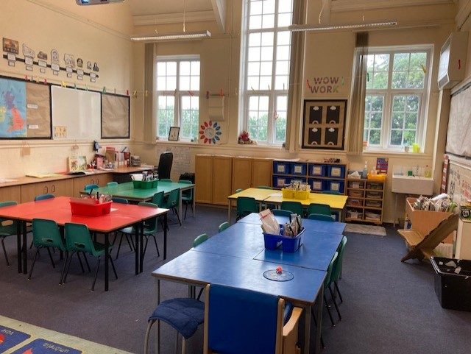
Our Classroom

Slide 3
New school year = new challenges.
In Year 2 we encourage the children to be as independent as possible. They are encouraged to change their own reading books and take more responsibility for their equipment and resources.
This year, the children will have their own pencil cases with their own equipment.

Slide 4
Our class timetable.
In the first part of the Autumn term we will focus heavily on PSHE. We will cover lots of work on keeping clean and healthy, our feelings and emotions and our transition into Year 2.
Each day we will have Read Write Inc, English and Maths lessons.

Slide 5
Our class timetable continued...
Here’s an example of a typical day …
8.45 – 8.55 – Children welcomed into school and complete a morning activity.
9.00 – 10.00 – Read Write Inc
10.00 – 10.30 – English
10-30 – 10.40 – Assembly
10.40 – 10.55 – Playtime
10.55 – 12.00 – Maths
12.00 – 1.00 - Lunch
1.00 – 1.30 – Mastering number, Dough gym and Handwriting
1.30 – 3.15 – PSHE / Science / P.E / ICT / Music / History / Geography (spread across the week)
The children will hear lots of stories at intervals throughout the day.

Slide 6

P.E
In the Autumn term, children will have P.E on Wednesday and Thursday. They will need to come to school dressed in their school P.E top, black joggers / leggings / shorts (depending on the weather) and a hoodie in their house colour. The clothes they wear for P.E should not be branded where possible.
P.E will be outdoors unless the weather is poor.

Slide 7
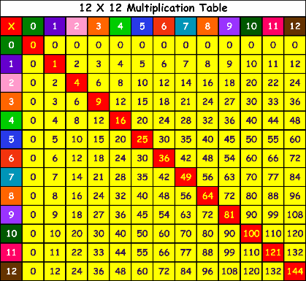
Times table rocket.
The children will continue to progress through the times table rocket.
Bronze – To know the 2x and 10x tables and division facts.
Silver – To know the 5x tables and division facts.
Gold – To know 2x, 5x and 10x tables facts (under 10 seconds for each fact).
Platinum – To count on insteps of 2,3,5 and 10 from any number forwards and backwards

Slide 8

Spelling bee
There are 5 steps for each coloured band.
The children need to get each spelling correct, which are taken from the year 1 and 2 high frequency words. They will have the opportunity to be tested daily if they have practised and feel they are ready to be tested. Miss McCormack will present them with their spelling band when they have completed each step.

Slide 9
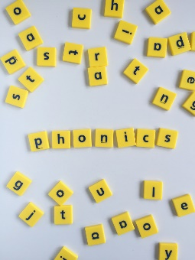
Phonics screening
Children in year 2 will continue to be taught phonics. For those children that did not pass the phonics screening test in Year 1, they will be able to resit this test in the summer term of Year 2.
RWI videos can be accessed from home to help the children consolidate their phonics.

Slide 10
SATS
Historically, children in Year 2 are given set tests that are given across the country.
As of this year, there is no statuatory requirement for children in year 2 for children to take these tests.
Other assessments may be released nearer the end of the school year.

Slide 11

Homework
Homework will be set online using some of the online platforms we use in school (LEXIA, Mathletics, My Maths, Spelling Shed and Purple Mash). Your child should have already been given all their log in details. If you are unable to access the internet please let me know and we can provide a paper based version where possible. It is really important children complete their homework and access our learning platforms regularly.

Slide 12
Reading books
Children will receive a RWI book matched to their level each week. This should be read multiple times across the week.
They will also come home with AR books matched to their level. These can be changed once children have read them. Please sign their reading records so we know children are ready to complete their quizzes.

Slide 13
Keeping in touch
Facebook
Marvellous Me – Let me know if you need a new code
School website
Every morning on the yard
If you have any queries or questions please ring school and I will call you back.

