Slide 1








YEAR TWO: SUMMER TERM 2026
Information for parents and carers
Working together, we succeed
ENGLISH
MATHS
This term, we will learn how to create a biography by learning all about Roald Dahl. We will read the book 'The Bear and the Piano' in Summer two. We will unpick the Bear and the Piano stories to help us develop our comprehension and writing skills. Every week, we will continue to learn a new spelling rule and be tested on these spellings every Friday. The children can practise their spellings on spelling shed.
We will spend lots of time focusing on our handwriting, making sure we can form our letters perfectly.
We will cover these areas throughout the term:
Reading and writing numbers in words and figures
Identifying odd and even numbers
Properties of numbers and number sequences
Finding fractions of shapes
Adding and subtracting
Multiplication and division.
Children will be set Maths activities on our online Apps Mathletics and My Maths to help consolidate learning in school and build their maths fluency. Encouraging children to use TTRS will help develop their multiplication skills.
SCIENCE
We will ne identifying, comparing and investigating the suitability of a range of everyday materials and finding out about famous Scientists and their work. After half-term we’ll learn about living things and their habitats.
HISTORY
PE
Our topic this term is called Great Women. We will learn about the lives of Mary Seacole and Grace Darling.
We will learn about ...
  the Crimean war and how both women supported the soldiers.
  the difference between their work
  How they changed the way we nurse today.
Games for understanding (Thursday)
Stick Skills - (Friday with NUF).
MUSIC
GEOGRAPHY
We will learn a song called the Friendship Song We will learn how to play the glockenspiels, identifying notes and playing them in time to the song.
In Geography, we will cover the unit What is it like to live at the coast. We will learn
  Locational knowledge—feature of the coast.
  the names of the 5 oceans and 7 continents
  how to use maps and Aerial views to identify features

Slide 2






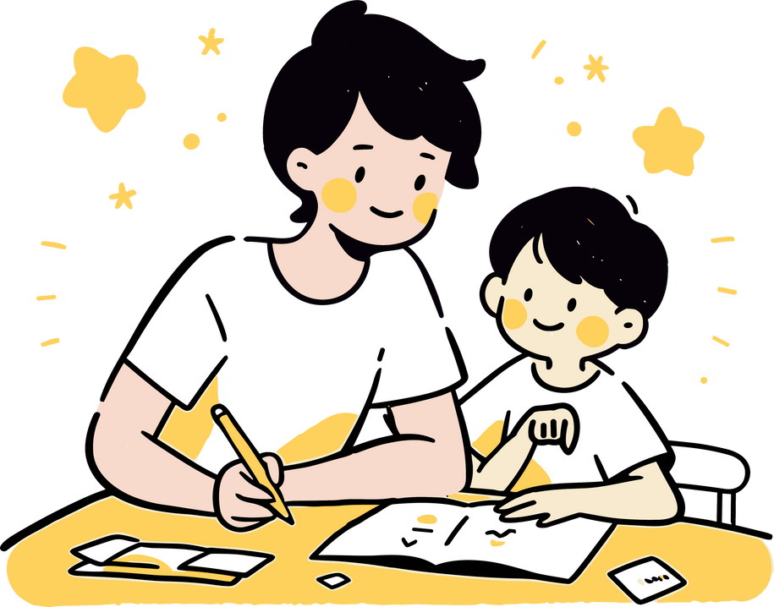



RELIGIOUS EDUCATION
ART & DESIGN
We will complete two topics over the Summer term.
  Torah and Shabbat
  Judaism – Beliefs and Practices.
Paint and Mixed Media – The children will learn how to create a collage making their own textured paper to create a seaside image. .
DESIGN TECHNOLOGY
COMPUTING
We will learn how to create a healthy wrap, learning about the different food groups and how to combine ingredients to create a healthy, balanced meal.
This term is all about programming. Firstly learning about robot algorithms and giving clear instructions to the BeeBots then after half-term we’ll be using Scratch Jr to learn about simple coding.
HOMEWORK
RWI and Accelerated Reader books (for those who are ready) will be sent home daily. Please return these everyday.
Children will be set asignments on Mathletics and My Maths to help consolidate their maths learning. Children will be encouraged to access TTRS to help develop their times tables knowledge.
Spelling assignments are set weekly on Spelling Shed. Weekly spelling tests (FRIDAY) are based on all spelling patterns covered in Key Stage 1 as well as the new spelling patterns. Some children will be set spellings based on the sounds they are learning in RWI.
We will ocassionally set topic based homework which will be more creative, based on something they are learning in school. Plese support your child with their homework.
DIARY DATES (SEE WEBSITE FOR MORE DIARY DATES)
20.04.2026 - Welcome back to school
21.042026 - Year 2 trip to the museum – all day.
24.04.2026 - House Matches – children to wear P.E kits.
04.052026 - BANK HOLIDAY – School closed to staff and pupils.
11.05.2026 - After school clubs start.
21.05.2026 - Tennis house matches.
22.05.2026 - Break up for half term.
01.06.2026 - Welcome back to school.
08.06.2026 - Phonics screening check. Opportunity for year 2 pupils to re-take the check.
10.06.2026 - RISE parent information session – more information to follow.
22.06.2026 - Water Safety Week and Assessment week.
22.06.2026 - Last week for clubs.
01.07.2026 - Class swap morning.
03.07.2026 - KS1 celebration afternoon. All KS1 parents welcome – More information to follow.
06.07.2026 - Health and Sports Week.
13.07.2026 - Sports Day
14.07.2026 - Annual Reports sent home.
16.07.2026 - Break up for Summer. School closed on Friday 17th July.
www.crookhillprimary.org (check our class page for news from our class)

